Slide 1



$$GND$$
$$V_{in}=3.3 \text{V}$$
$$V_{out}≈ 1.65 V$$

Slide 2



$$V_{out}≈0 V$$
$$GND$$
$$V_{in}=3.3 \text{V}$$

Slide 3



$$V_{out}≈3.3 V$$
$$GND$$
$$V_{in}=3.3 \text{V}$$

Slide 4
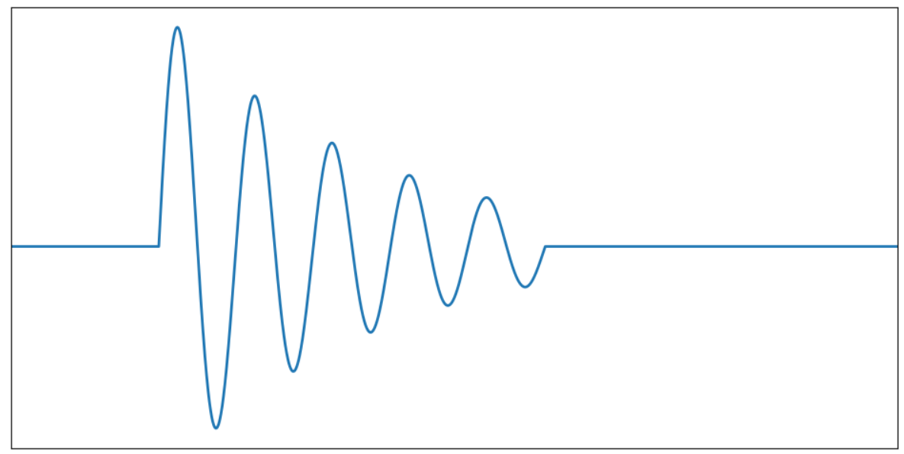






+peak 1
+peak 2
$$ΔT_{+}$$
$$Δθ_{+1}$$
$$Δθ_{+2}$$
0 Deg
$$Δθ_{−1}$$
$$Δθ_{−2}$$
$$ΔT_{−}$$
-peak 2
-peak 1

Slide 5
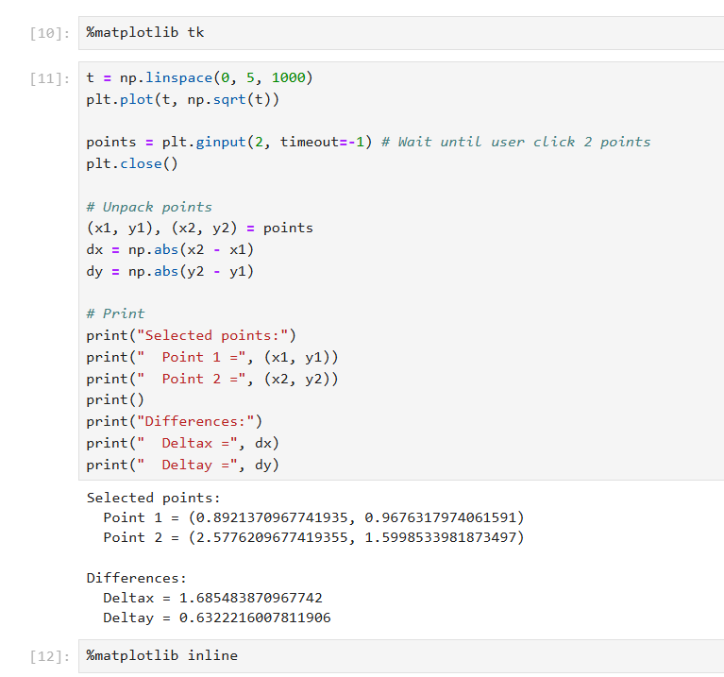
turn of tkinter-GUI
turn off tkinter-GUI

